Slide 1
Face Mask Usage Detection
Team Styracosaurus CPEN 291
Azwad Sadman, Chunhao Zhu, Jessica He, Kevin Shen

Slide 2
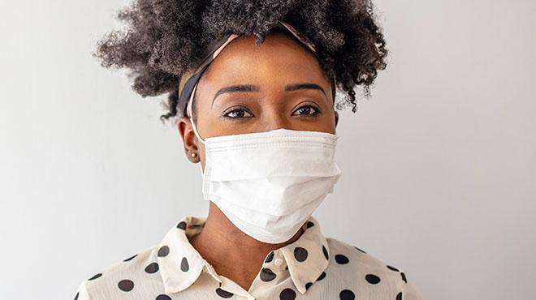
Introduction
Amidst COVID-19, wearing face mask has become the norm
But in order for face masks to be effective, it must be worn correctly
Our project is a website that can identify if someone is wearing a mask correctly or not

Slide 3
Demonstration
Website: http://correct-mask-detection.herokuapp.com/
Mobile application demonstration at end of video

Slide 4
Machine Learning Component
Machine Learning
Data analysis that automates analytical model building
Idea: Systems can learn from a dataset, identify patterns and make decisions
Model eventually becomes “smart” enough to accurately predict
Dataset
ML Model

Slide 5
Our Model
Residual Networks (ResNet) is a classic neural network (CNN) used for many computer vision tasks
We used ResNet-18 due to its proficiency at image analysis and classification
Transfer learning was done on ResNet’s pretrained model
Have to change and train the last layer
Correctly worn
Input Image
ML Classifier
Incorrectly worn

Slide 6
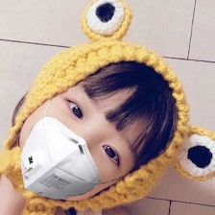
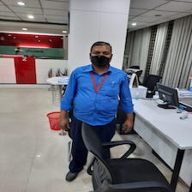
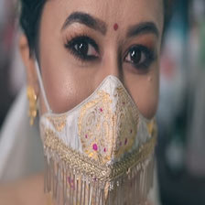
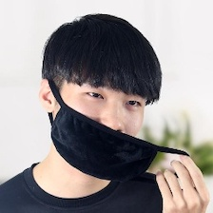
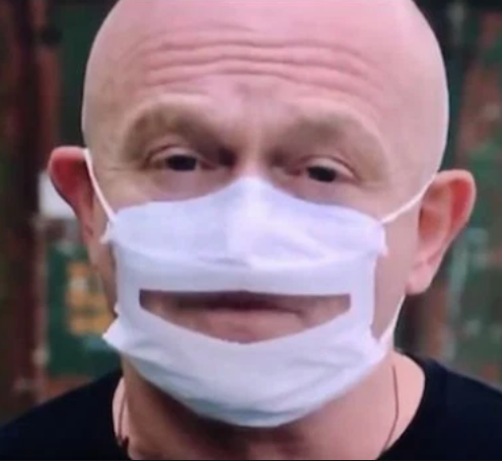
Our Dataset
More than 2000 images of correctly and incorrectly masked faces
All ages, ethnicity and physique
Different angles and distances (!)
Incorrectly masks such as uncovered nose, masks on chin, or even masks with holes

Slide 7
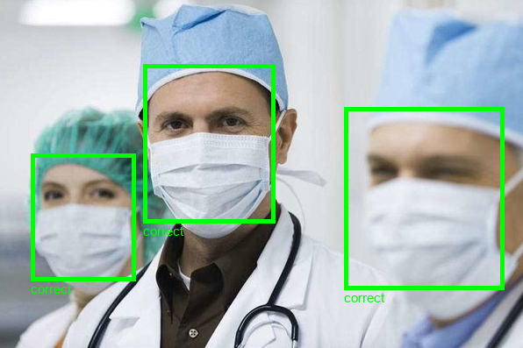
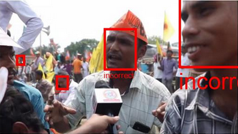
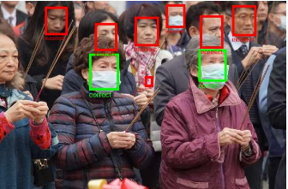
Limitation and Improvements
Struggles to classify images with more than one person in it
E.g. one correctly masked face, and one incorrectly masked face
Solution: Facial recognition

Slide 8


Non-ML Component
Django web application in Python from scratch
Deployed website with Heroku

Slide 9
Flow of Data
User uploads image
Saves to FileSystem Storage
Sends HTTP Request to predictImage
Process image in ML model in image_pred
Outputs result to HTML file and website

Slide 10
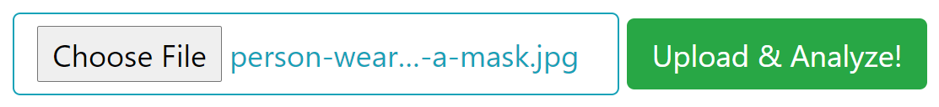
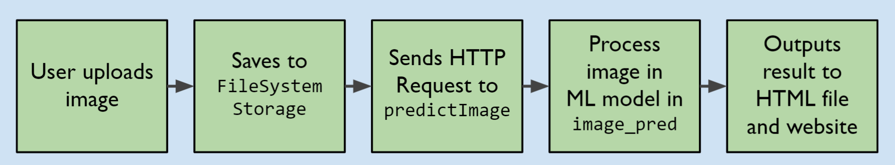
Handling Image Uploads
FileSystemStorage and /media/ folder

Slide 11
Making Predictions
predictImage(request) in views.py
image_pred(url) in my_model.py
Correct: out = 0
ML Model
Incorrect: out = 1

Slide 12



Outputting the Result
predictImage(request) in views.py
if pred == ‘Correct’
HTTPResponse object:
filePathName
pred (out)
interface.html
if pred == ‘Incorrect’
else

Slide 13
Thank You
Azwad Sadman, Chunhao Zhu, Jessica He, Kevin Shen

